Slide 1
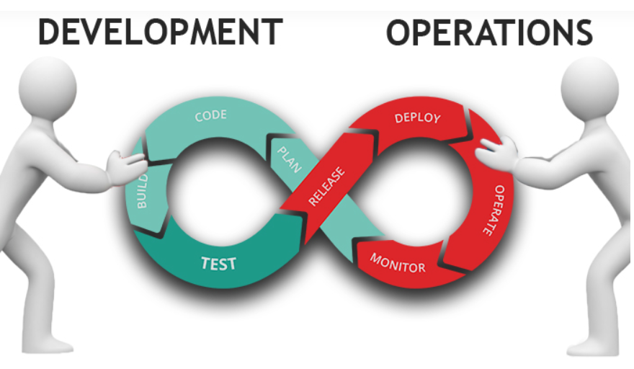
What is DevOps

Slide 2
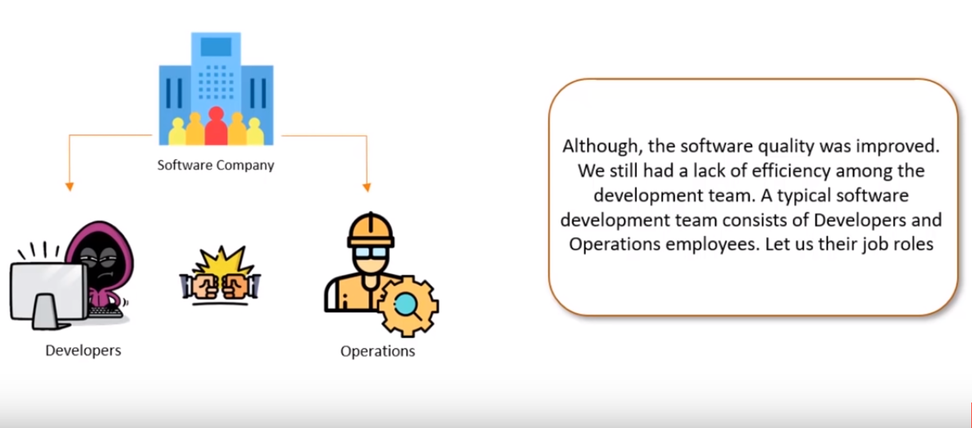
Why DevOps?

Slide 3
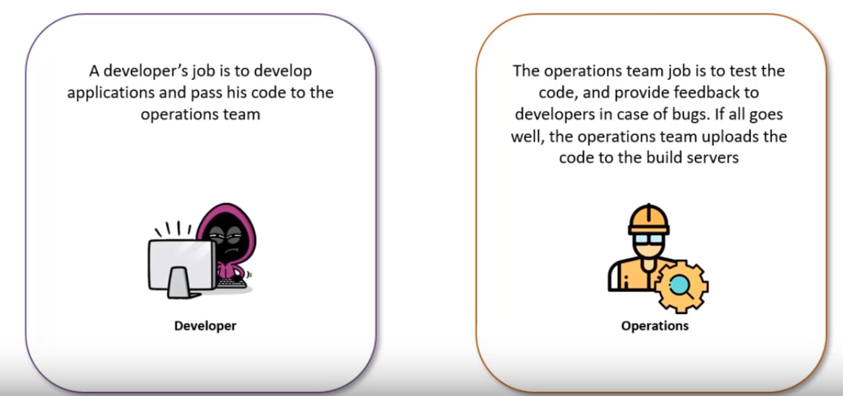
Why DevOps?

Slide 4
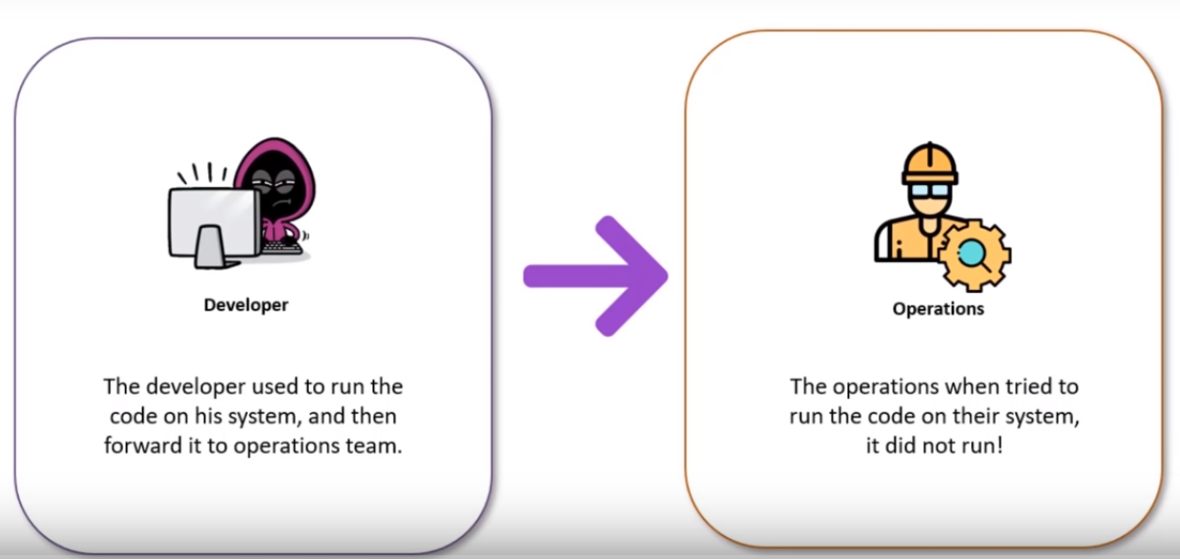
Why DevOps?

Slide 5
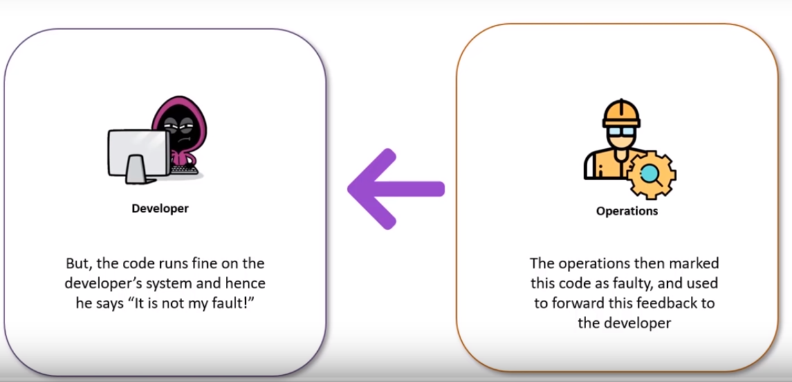
Why DevOps?

Slide 6
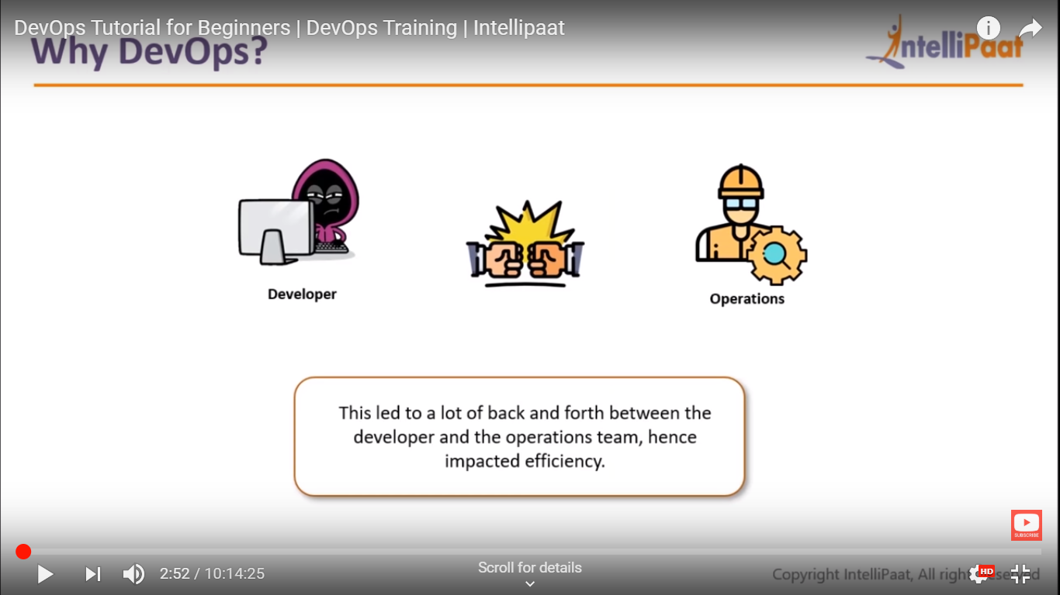
Why DevOps?

Slide 7
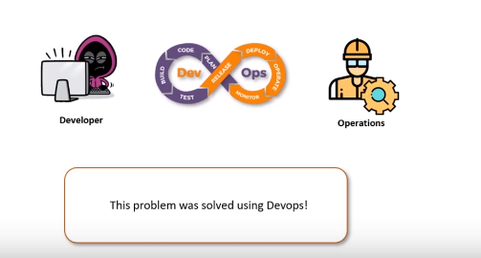

Slide 8
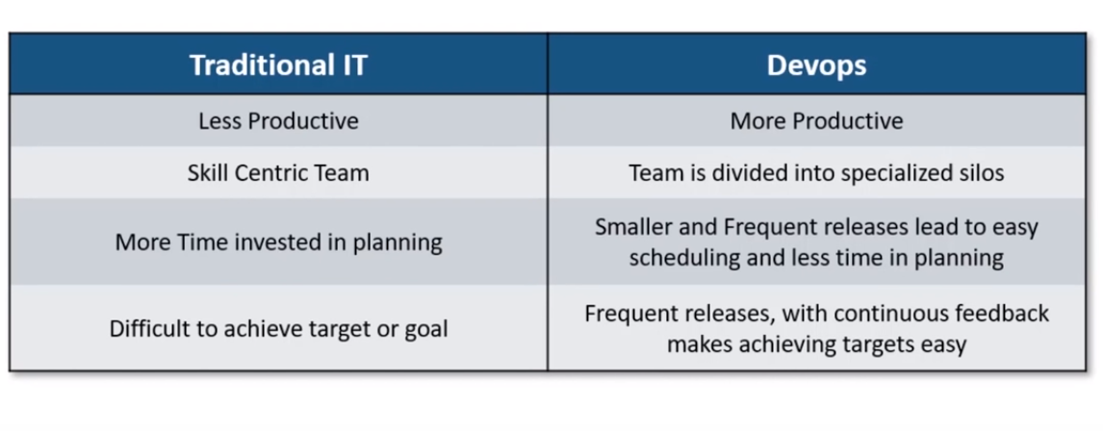
Traditional IT and DevOps

Slide 9
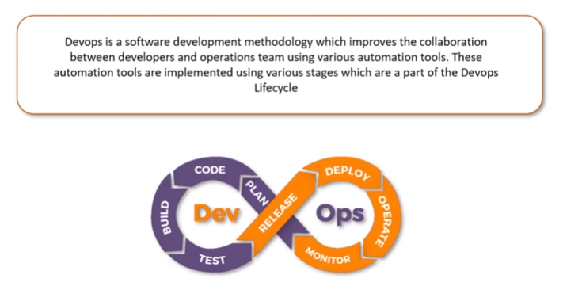
What is DevOps?

Slide 10
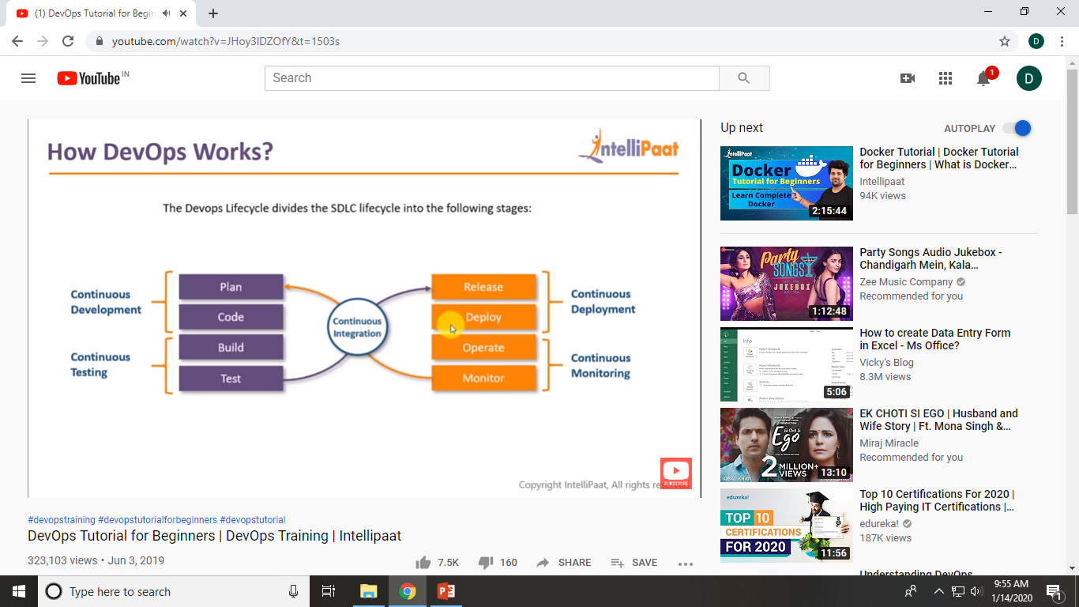
DevOps Lifecycle
Notes:
‹#›

Slide 11
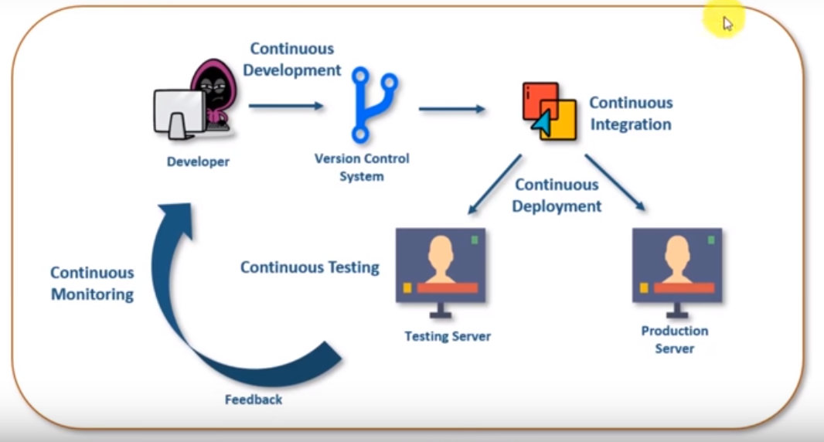
How DevOps Work? (Automated CI/CD pipeline)

Slide 12
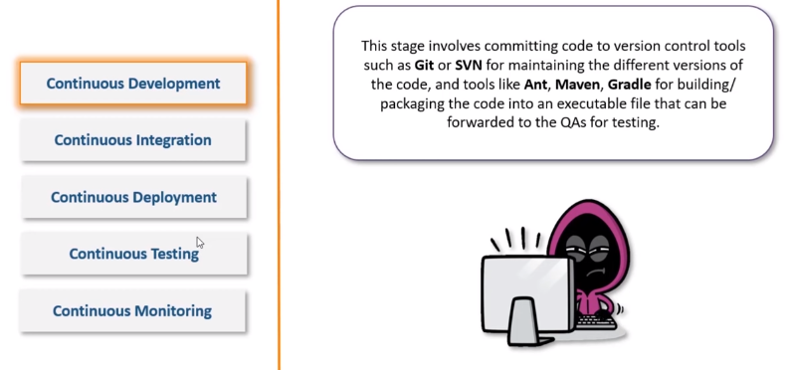
How DevOps Works?

Slide 13
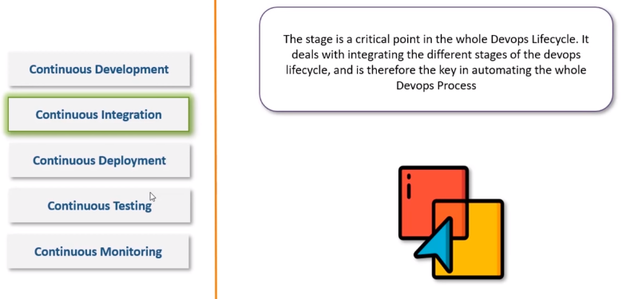
How DevOps Works?

Slide 14
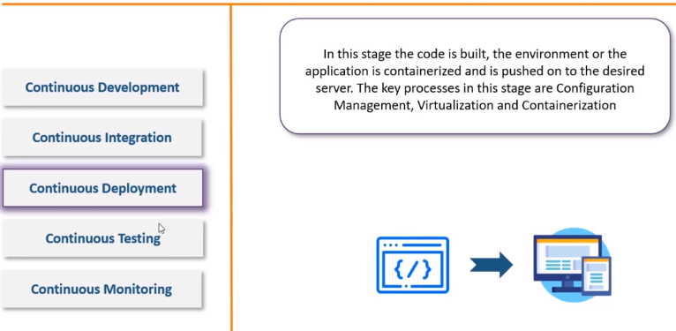
How DevOps Works?

Slide 15
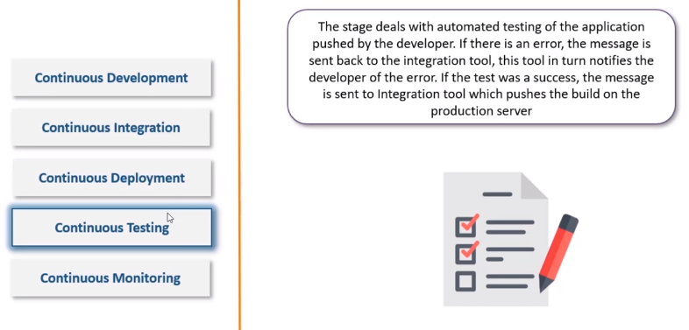
How DevOps Works?

Slide 16
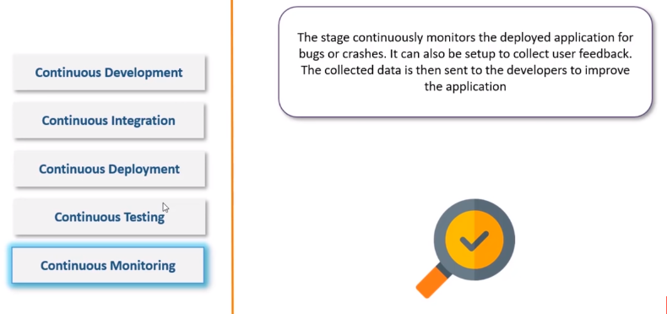
How DevOps Works?

Slide 17
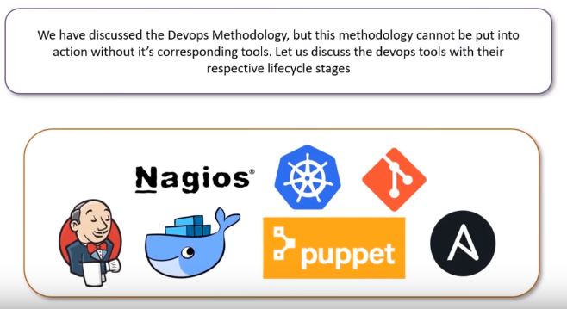
DevOps Tools

Slide 18
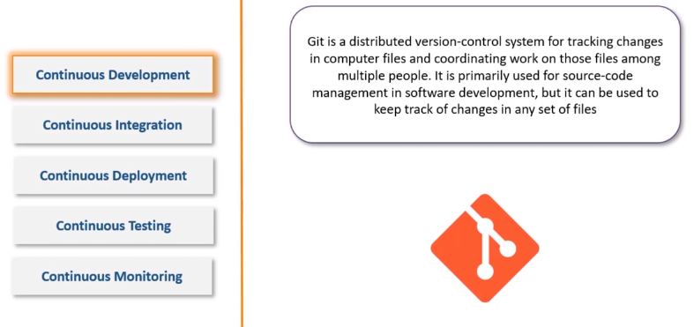
DevOps Tools

Slide 19
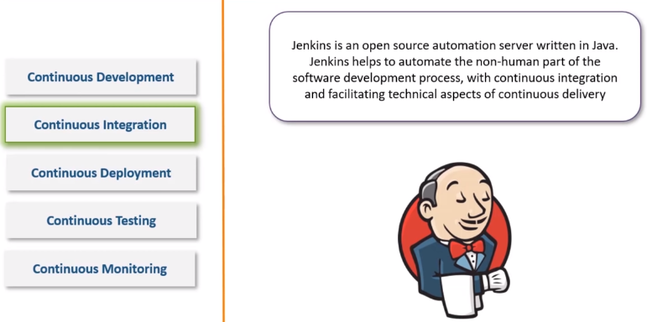
DevOps Tools

Slide 20
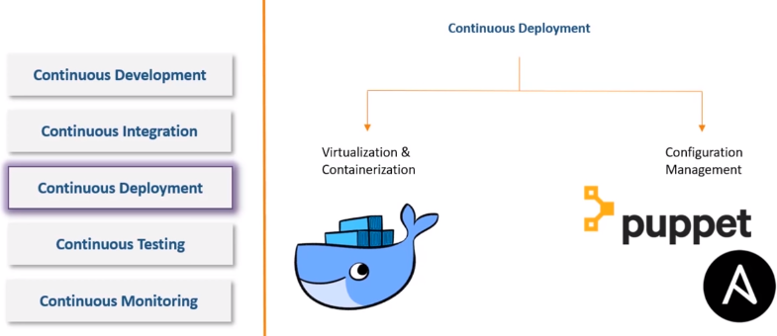
DevOps Tools

Slide 21
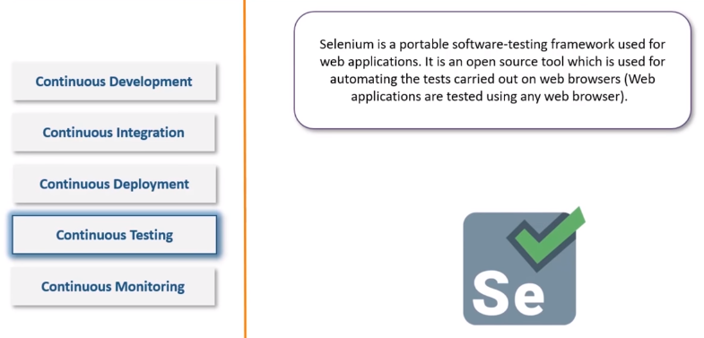
DevOps Tools

Slide 22
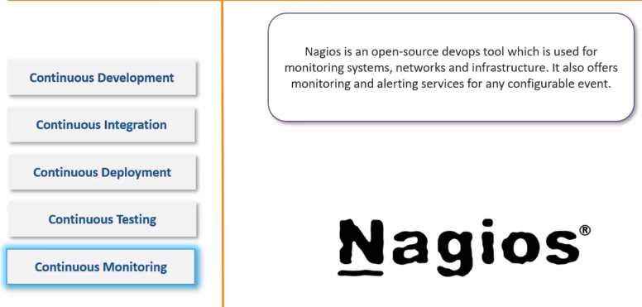
DevOps Tools

Slide 23
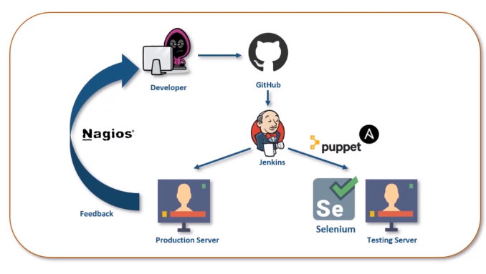
DevOps Lifecycle

Slide 24
References
DevOps Tutorial for Beginners: Learn Now (Training Course)
https://www.youtube.com/watch?v=mBBgRdlC4sc

